Slide 1
CUSTOMER RETENSION
CASE STUDY

Slide 2
PROBLEM STATEMENT
To find the combination of both utilitarian value and hedonistic values that affect the repeat purchase intention (loyalty) positively.

Slide 3
DATA ANALYSIS

Slide 4
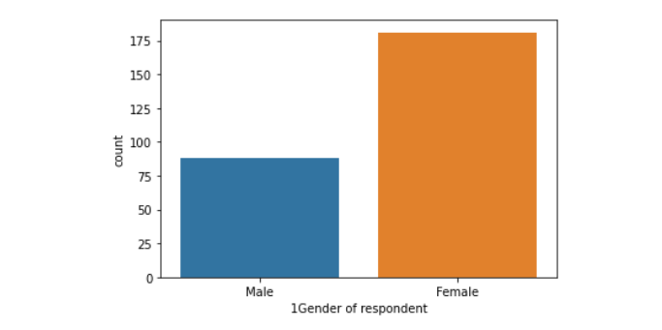
GENDER
Female participants is more compared to male participants.

Slide 5
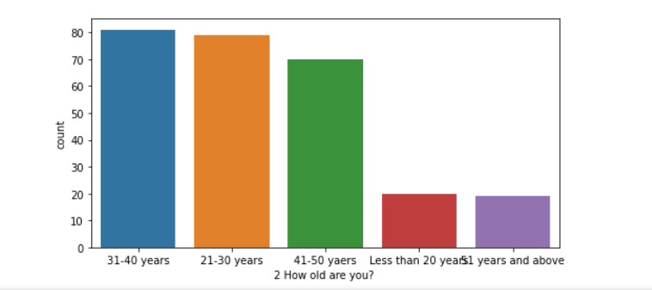
AGE
Young people are doing more online purchases than teens and middle age.

Slide 6
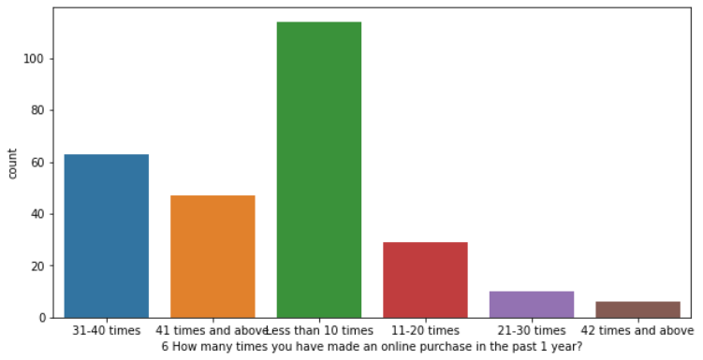
Retention Trend

Slide 7
CORRELATION
* How old are you? 0.278446
Which channel did you follow to arrive at your favorite
online store for the first time? 0.243183
* Shopping on the website helps you fulfill certain
roles 0.180391
Offering a wide variety of listed product in several
category 0.178993

Slide 8
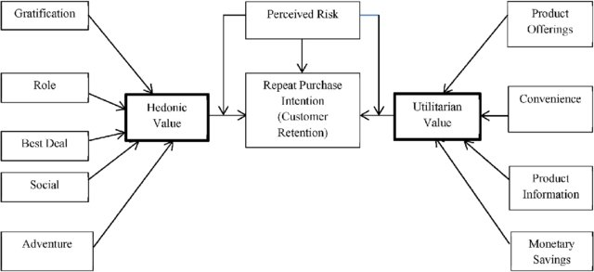
CONCLUSION

